Slide 1
NEURAL STYLE TRANSFER

Slide 2
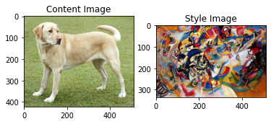
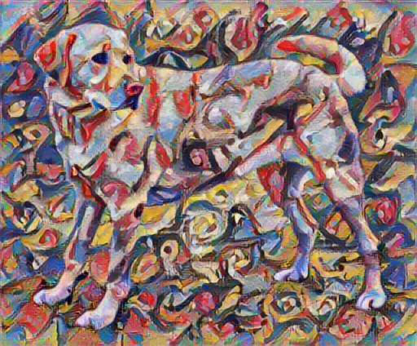
Introduction
Neural style transfer is an optimization technique used to generate new output image by taking two images – a content image and a style reference image(like an art by a painter).
The output image is a blend of the given two images so that it looks like the content image but painted in the style of the style reference image.
+
==🡺
Content Image
Style Image
Generated Image

Slide 3
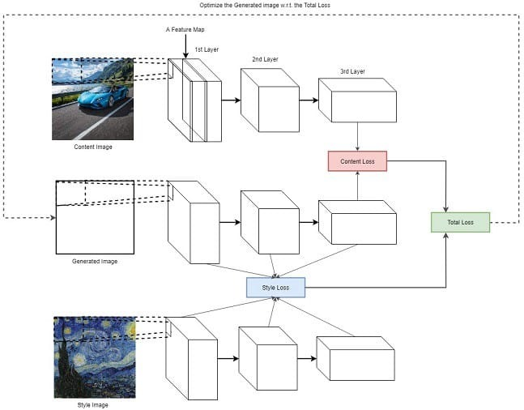
Implementation
Neural style transfer uses the concepts of deep neural networks to extract the features of the content image and the style image and use those features for the optimization.
We extract the features of the content image and style image using the vastly available pretrained neural networks like VGGNet .
Then, we define a loss function that blends the two images seamlessly to create visually appealing art.

Slide 4
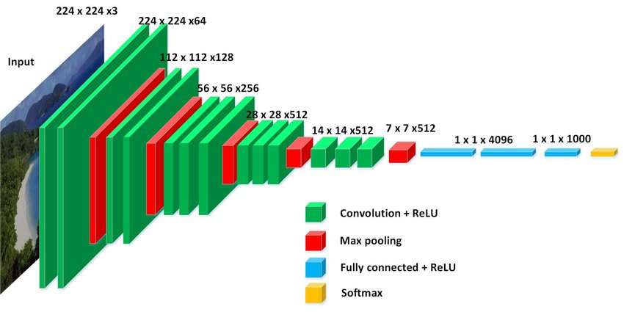
VGG16 Architecture

Slide 5
Extracting Features from VGG
We replace the final Max Pool Layer by Average Pool layer as Average Pool gives visually pleasing results in Neural Style Transfer.
We pass both the content image and the style reference image as inputs and extract the features from the Average Pooling layer and use it in our loss functions to optimize the results.
We also pass a generated image (sort of noise initially) to compute the required losses and use that image to update the pixel values so as to optimize the total loss function.
The following convention is used while defining loss functions
C – Content Image, G – Generated Image, S – Style Image

Slide 6
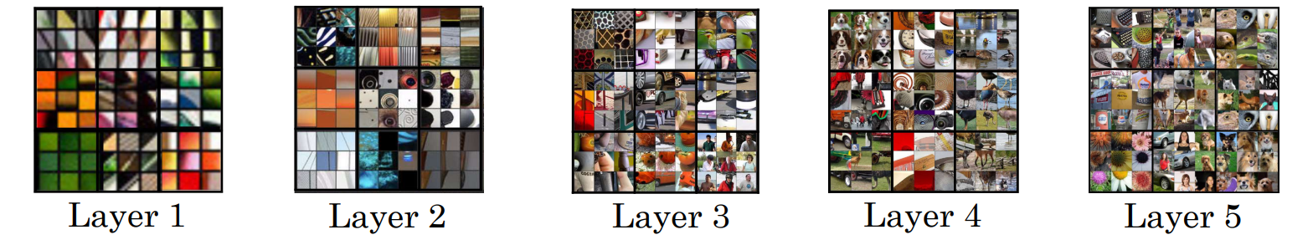
What are neural networks Learning
The given diagram gives an overview of what each layer is trying to learn in a neural network
We can observe that the early layers in the network are learning the easily extractable features such as edges and as the layers get deep, the network is learning or extracting the most complex features in the image

Slide 7
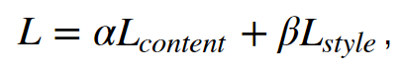
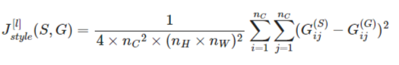
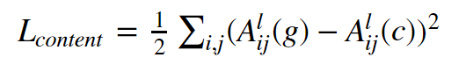
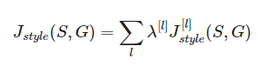
Loss Functions
The loss function in the Neural Style Transfer is defined as:
The loss function is computed by using content loss and style loss that are defined as following

Slide 8
Content loss
We obtain the activations of the Average Pooling Layer and these are the features that are extracted from VGG16 Network when generated and content images used as inputs.
Content Loss is given by

Slide 9

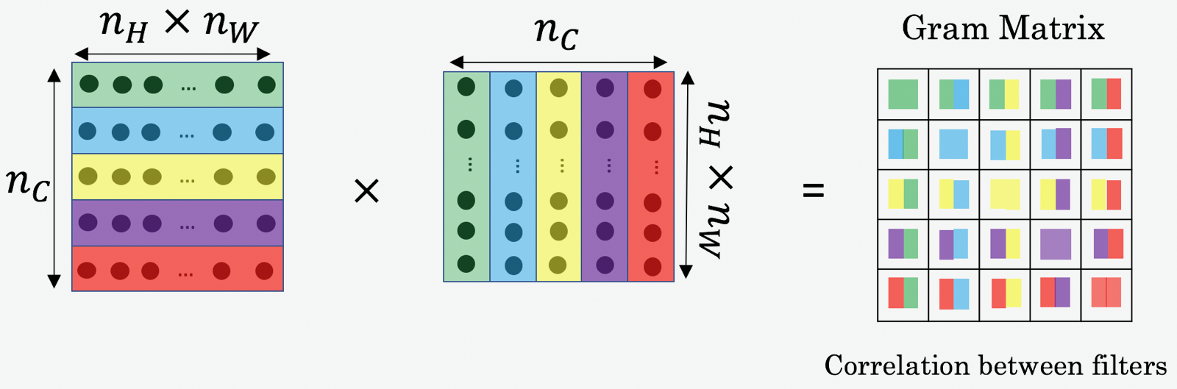
Style Matrix

Slide 10
Style loss
The activations are obtained from the different layers of the VGG network again for style image and generated image and these activations are used to compute the Gram matrices of the different layers and for a layer l the Style loss is given by
We add all the style losses for all the required layers and this gives us the total style loss given by

Slide 11
Optimization of loss Function
We minimize the Total loss computed using Content loss and Style loss given by
where alpha and beta are the hyperparameters.
Using gradient descent, we update the each pixel value of the generated image (dL/dG) using an appropriate learning rate and after multiple iterations, the final output image of the blend of the given Content and Style Images is obtained.
G = G – (learning_rate) * (dL/dG)

Slide 12
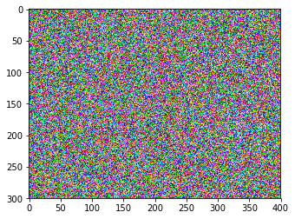
How to initialize generated image
We initialize the generated image initially using random values and hence initially the generated image looks like

Slide 13
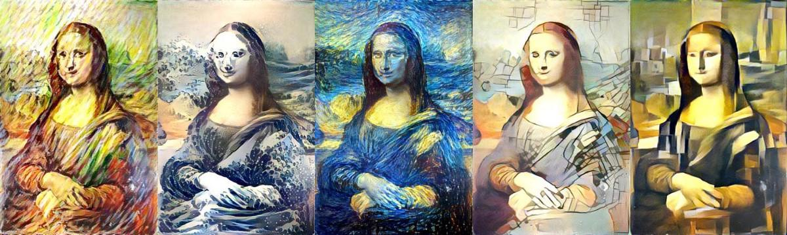
Generated images as we update the image

Slide 14
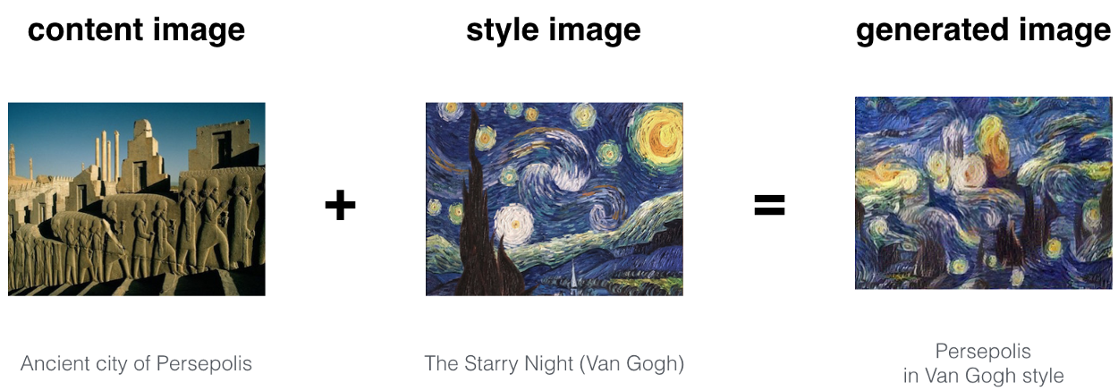
Examples

Slide 15
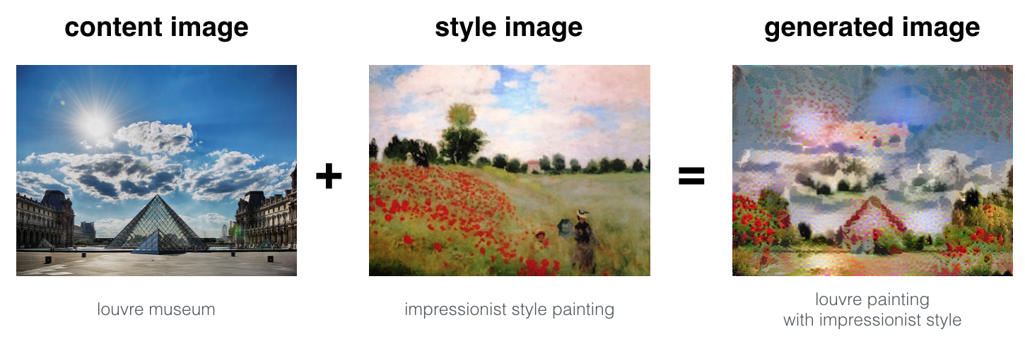
Examples

Slide 16
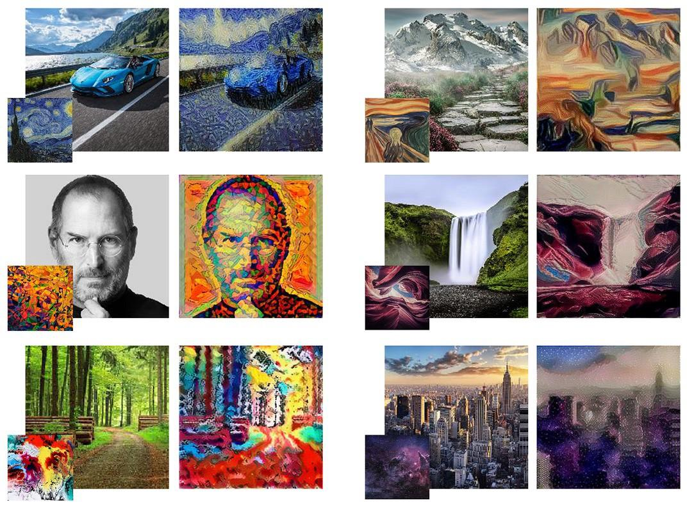
Examples

Slide 17
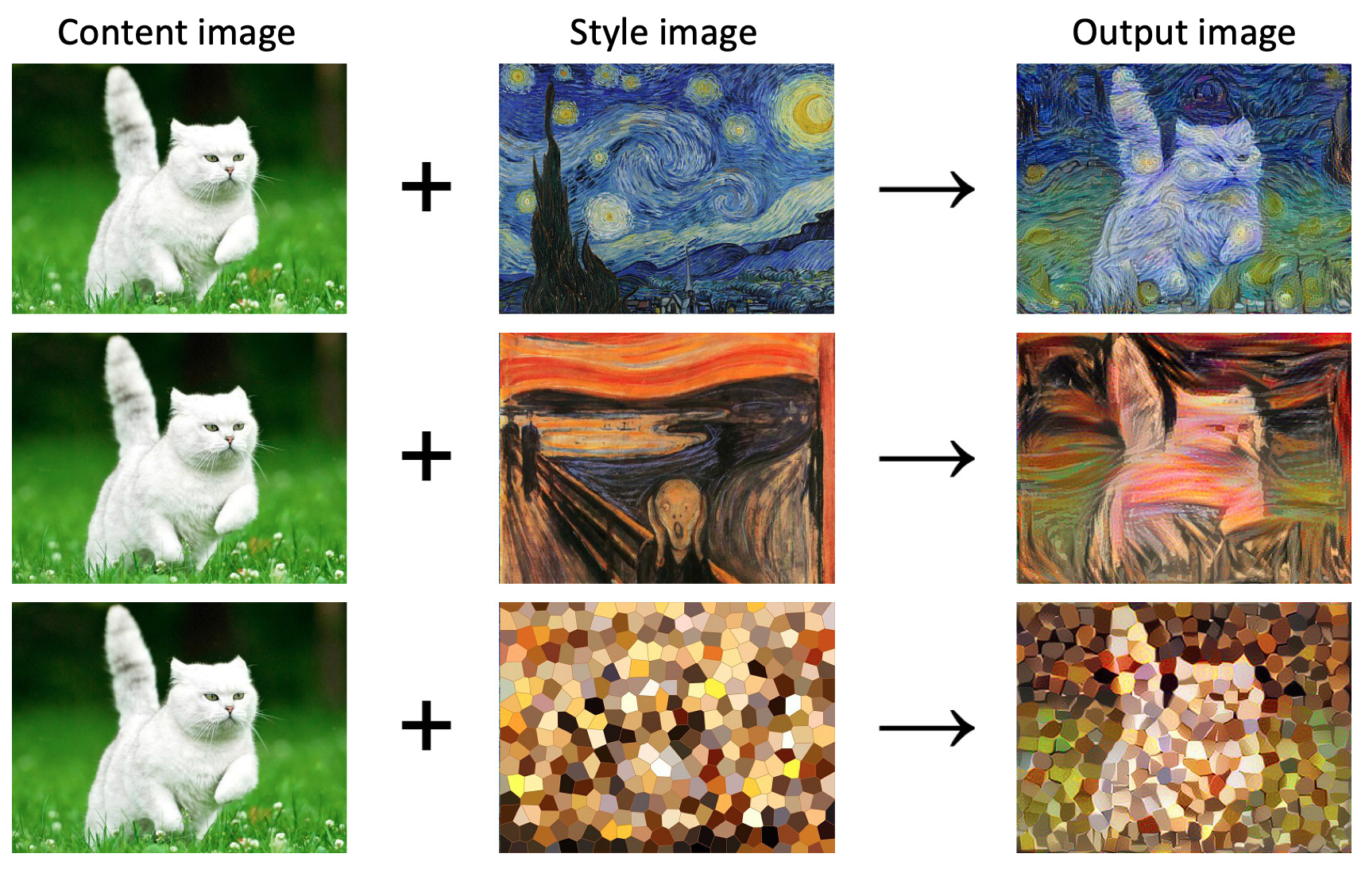
Examples

Slide 18
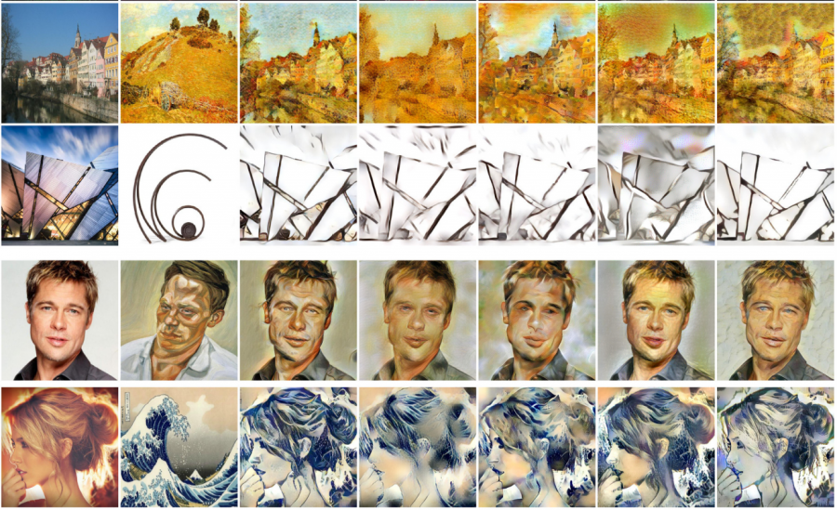
THE END WITH MORE EXAMPLES

Slide 19
Sources
Neural style transfer, convolutional neural network coursera by Andrew NG
Neural Style Transfer TensorFlow
Neural Style Transfer Analytics Vidhya
Neural Style Transfer Towards Data Science

